Slide 2
Jewellery Management system
Project Tittle | Jewellery Management System
Objective | A jewellery Management is a C#.net application where the user client data is entered Our main objective is to Keep record of all jewellery sold.
Type of application | Windows Form Application
Front end | C#.net
Other Tools | MS Office 2016
Project Guide | Prof. Nilesh Patel
Submitted To | Dept. Information Technology,VIT,Pune
Developed By | 1.Aditya Laddha 2.Ashwin Pijdurkar 3.Arjun Shinde 4.Sachin Khutan 5.Ashish Gawai

Slide 3
Existing System
As the current system is totally manual
Jewellery Shop has a manual on the paper
Existing system is manually,So it increase the chances of errors.
Lots of the time consumed for each report generation.
Immidiate response to the query’s is Difficult
Manual System Takes more time

Slide 4
Need for new system
System can generate immidiately getting the data and report
Avoid stationary expense.
Any record is easy to store and manage
Easy to solve customer query.
Easy to make purchase.

Slide 5
Functional Specifications
Admin can update jewellery price.
Admin can add or view products.
Admin can update design and icon.
Admin can generate bill.
Admin can generate category wise report.

Slide 6
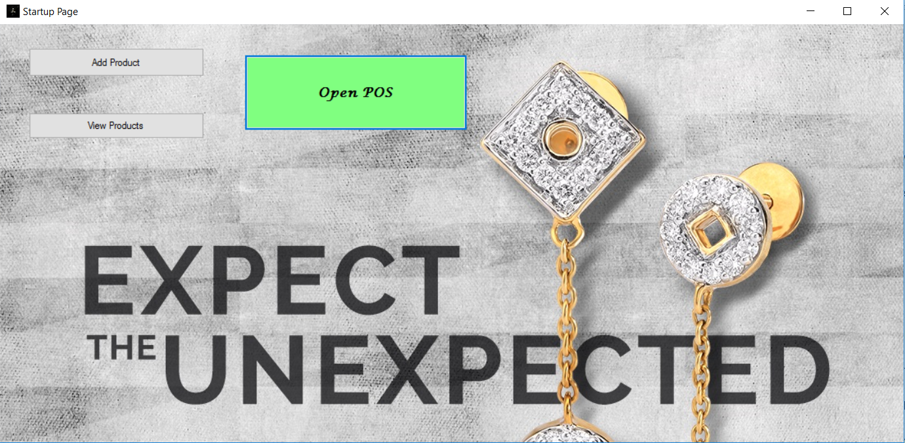

Slide 7
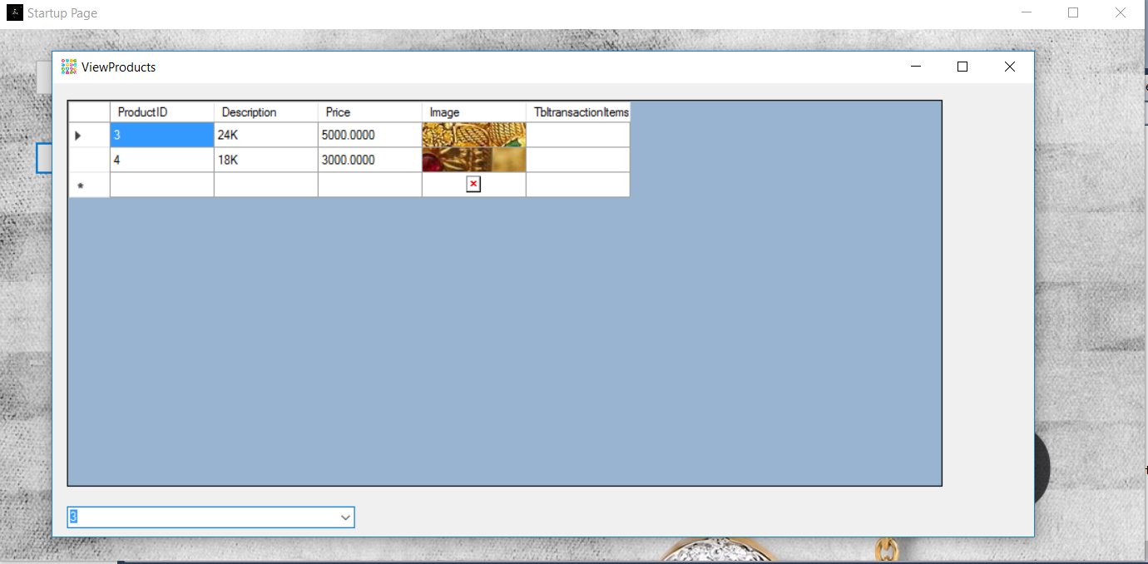

Slide 8
Point of Sale
Can add product category wise.
Select Quality of material.
List of items to be Purchased.
Items can be added or deleted.

Slide 9
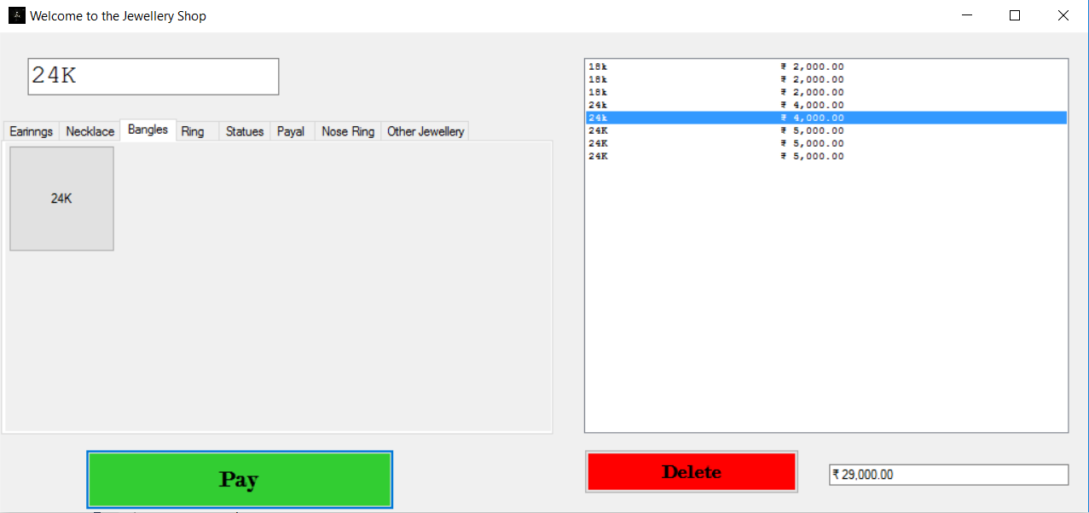

Slide 10
Payment Page
Billing Page is Displayed.
Amount to be Paid is shown according to items Purchased.
Amount Paid is to be entered.
Return amount is displayed.

Slide 11
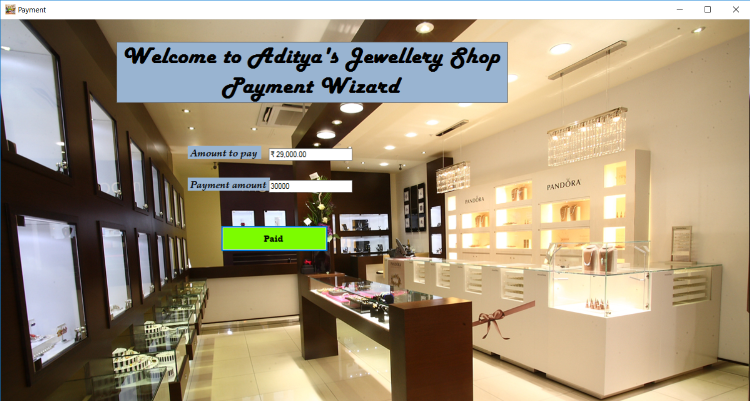

Slide 12
Thank You.

